Slide 1
Project 1- United Solar
Project 1- United Solar
Amplifire– Nicholas Kroeger, Samuel Kuhn, Jeff Janes, Parker Van Every, Taylor Billingsley
Developer Team:

Slide 2

Solar Panels Company
Production
Installation
Customers
Business
Households

Slide 3
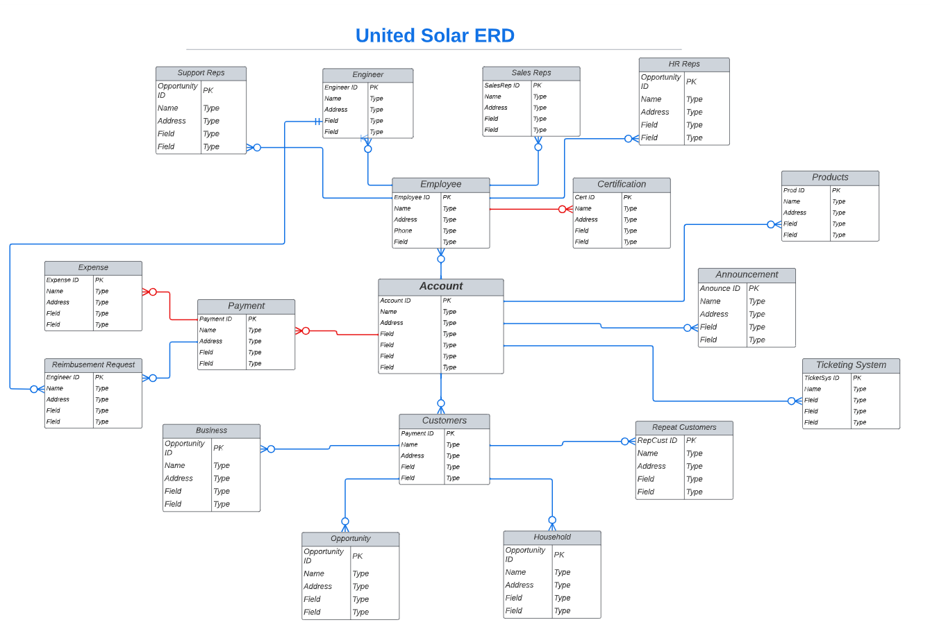
ERD and Implementation

Slide 4
Setup of Playground
Setup of Playground

Slide 5
Login/Security
User Access
IP Ranges
Work Hours
Account/Org Setup
Data Backup

Slide 6
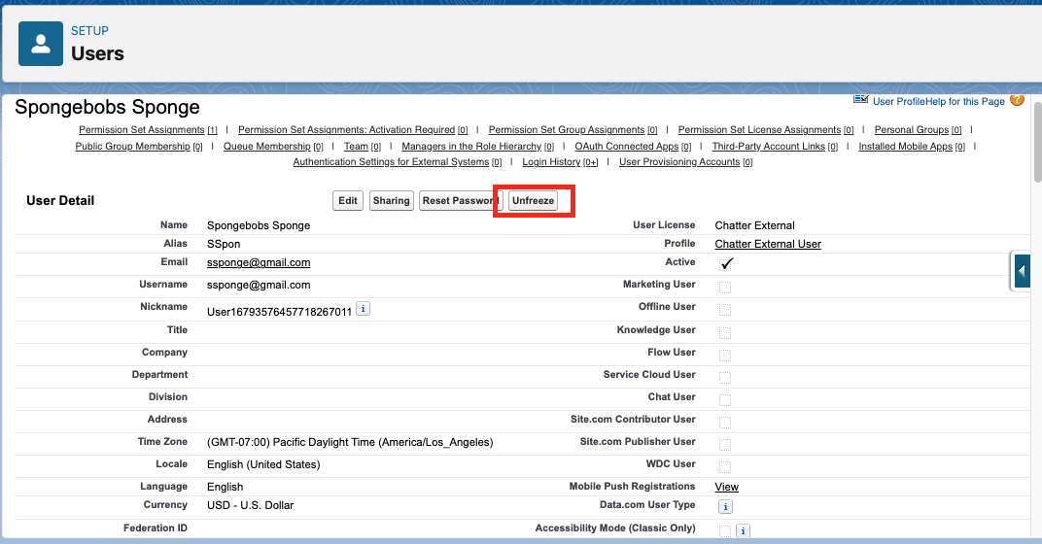
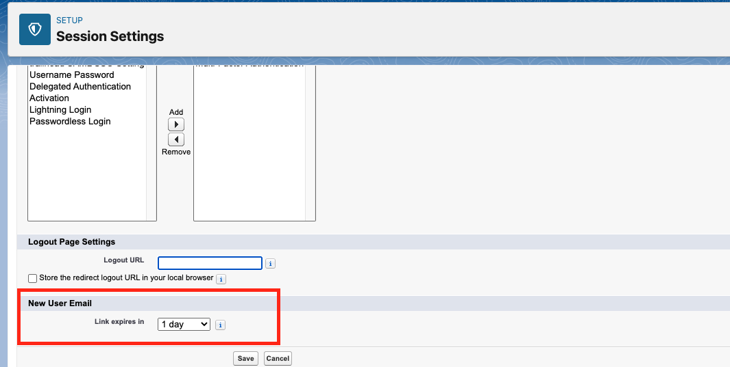
User Access

Slide 7
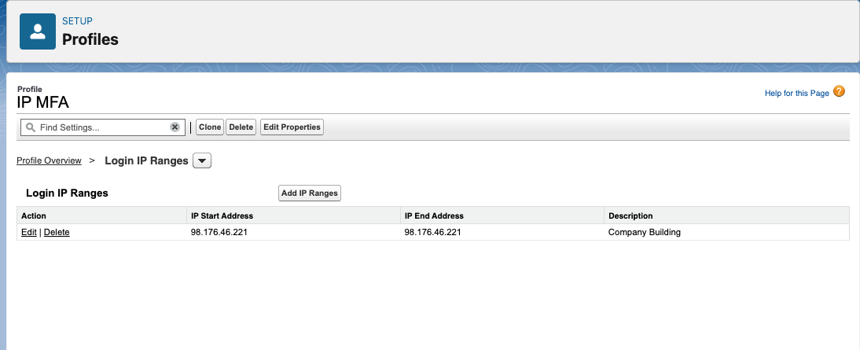
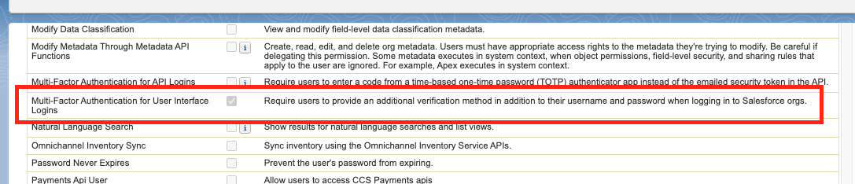
IP Ranges and Multi-Factor Authentication
Setup:
Network Access
Profiles

Slide 8
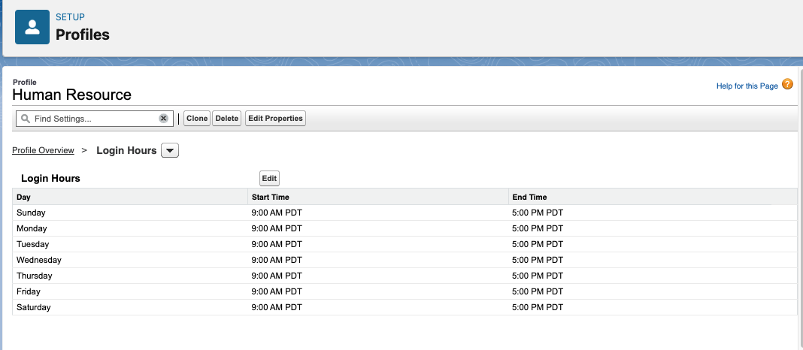
Work Hours
Setup:
Can be set through a profile
Can be set through Business Hours

Slide 9
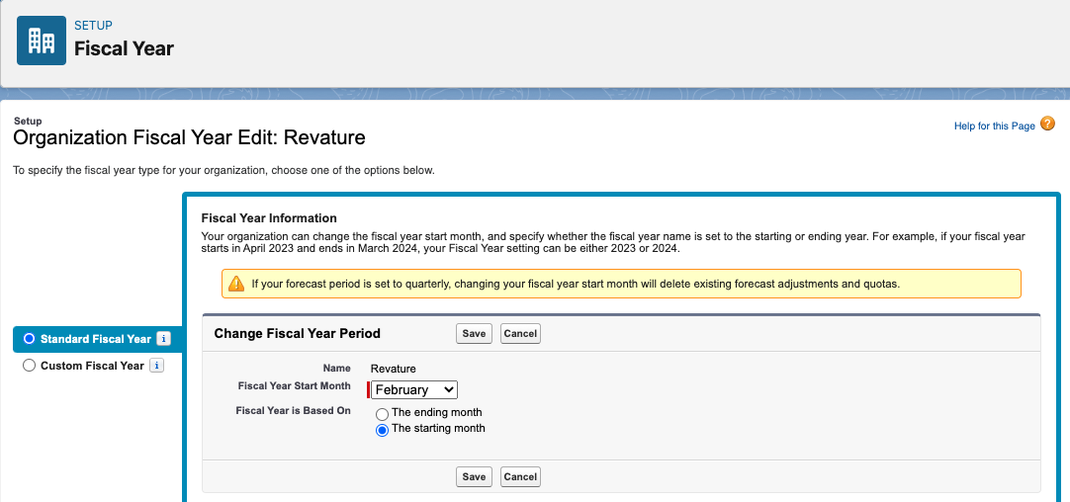
Account/Org Setup

Slide 10
Data Backup
Data Export Service
Data Loader
Report Export

Slide 11
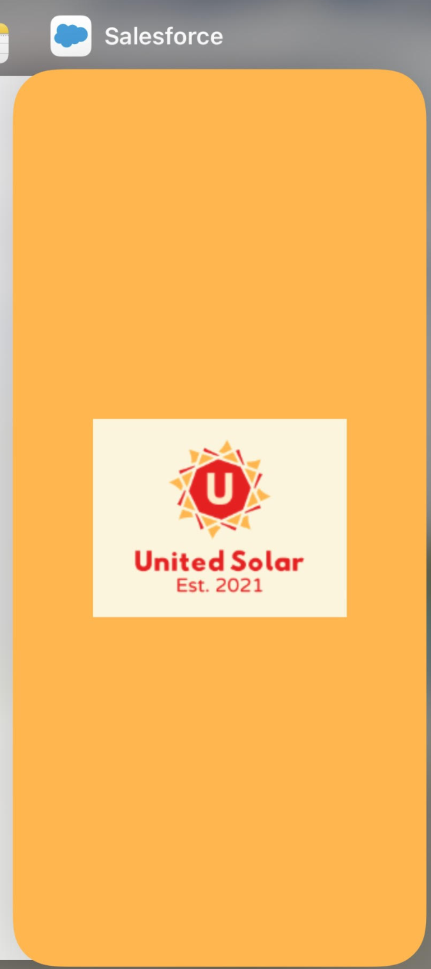
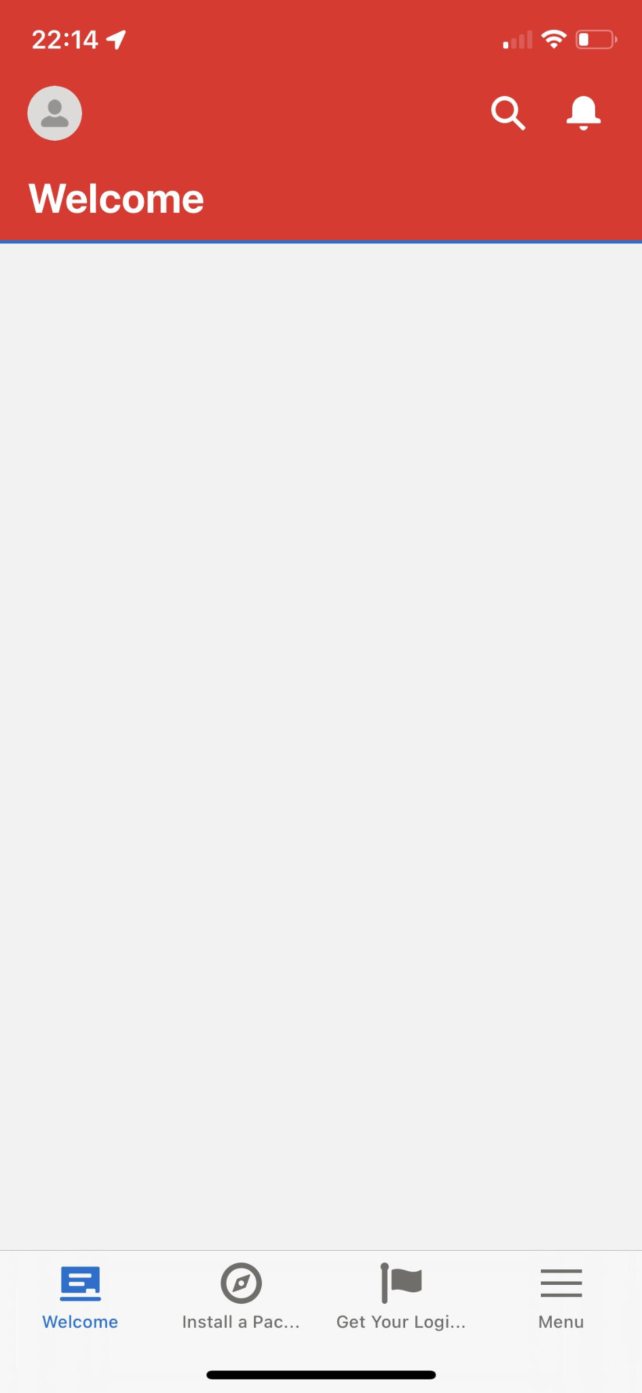
Mobile Branding
United Solar Colors!

Slide 12
Clients and Accounts
Clients and Accounts

Slide 13
Account Types (Household/Business)
United Solar requested to display only household type fields on account pages pertaining to Account Types of: Household
Record Type:
Household
Page Layout:
Household:
Modified to remove business related fields
Record Type:
Default
Page Layout:
Account Records
(Default)

Slide 14
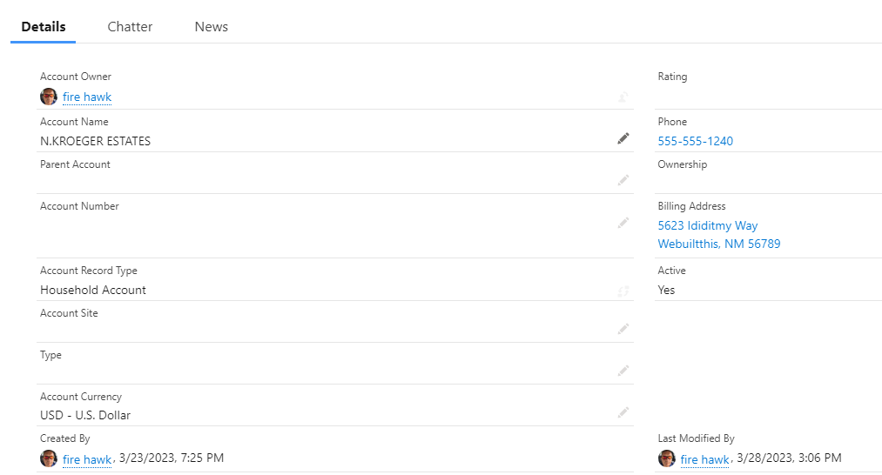
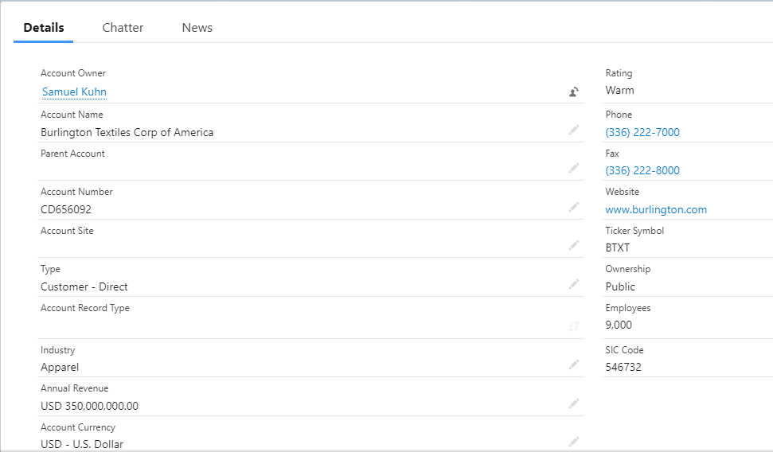
Account Types (Household/Business)
Business View
Household View

Slide 15
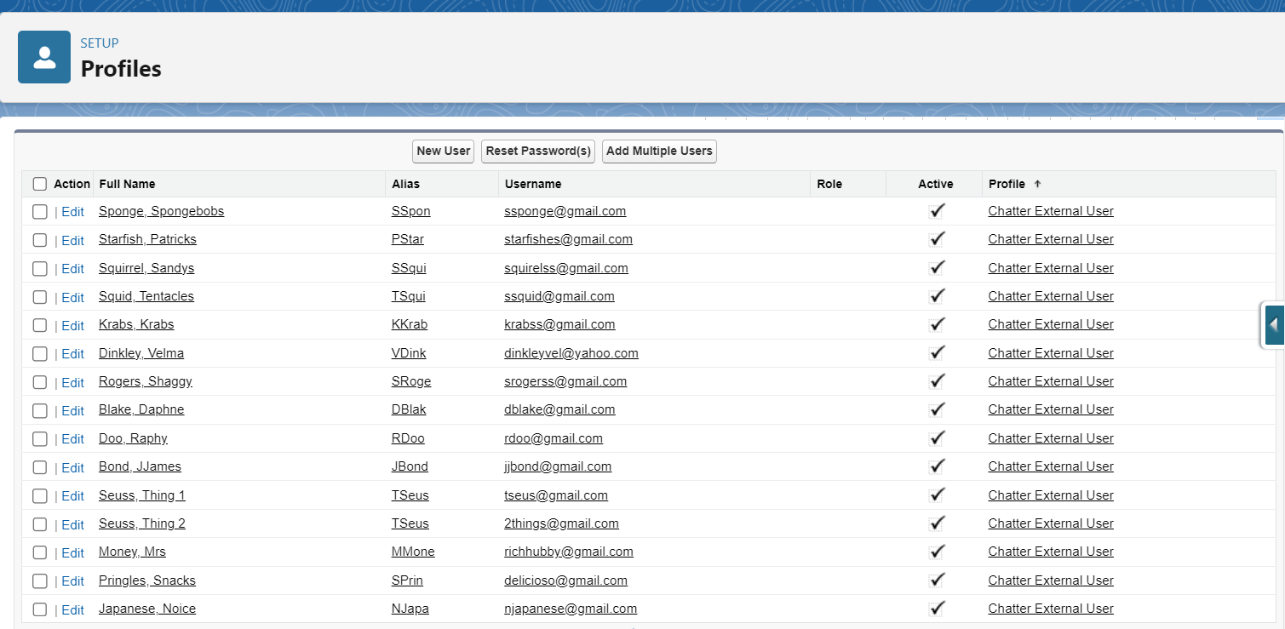
Client Interface and Benefits
User profiles generated for client
No login access until the client specifies
External Chatter licenses for each user
Ability to quickly grant login access by generating their passwords and notifying them
Missing login button
Notes:
Taylor ~ Use Case #11 Chatter Users for External Partners; functionality: users without login access until the company specifies

Slide 16
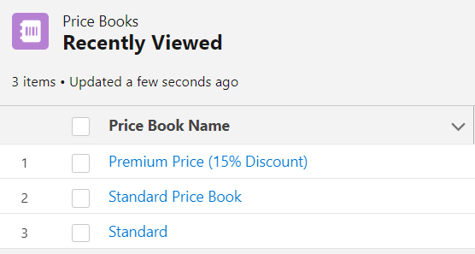
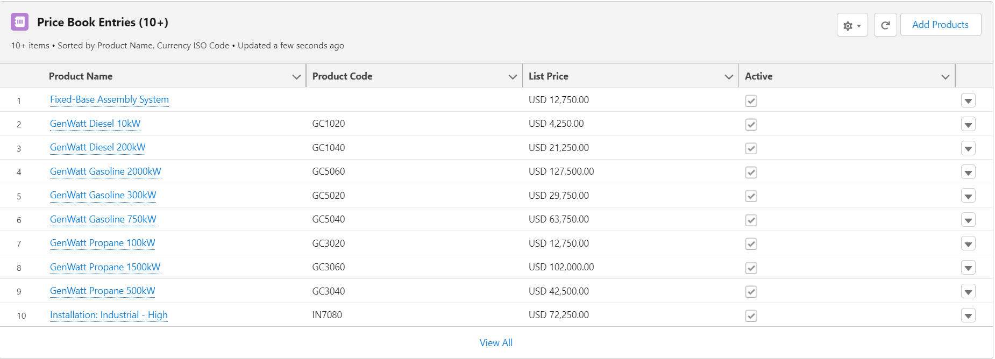
Client Interface and Benefits
Each price book entry is marked down by 15%
Discounted price book for United Solar’ customers
Price Book Customization!
Notes:
Taylor ~ 24: 15% Discount

Slide 17
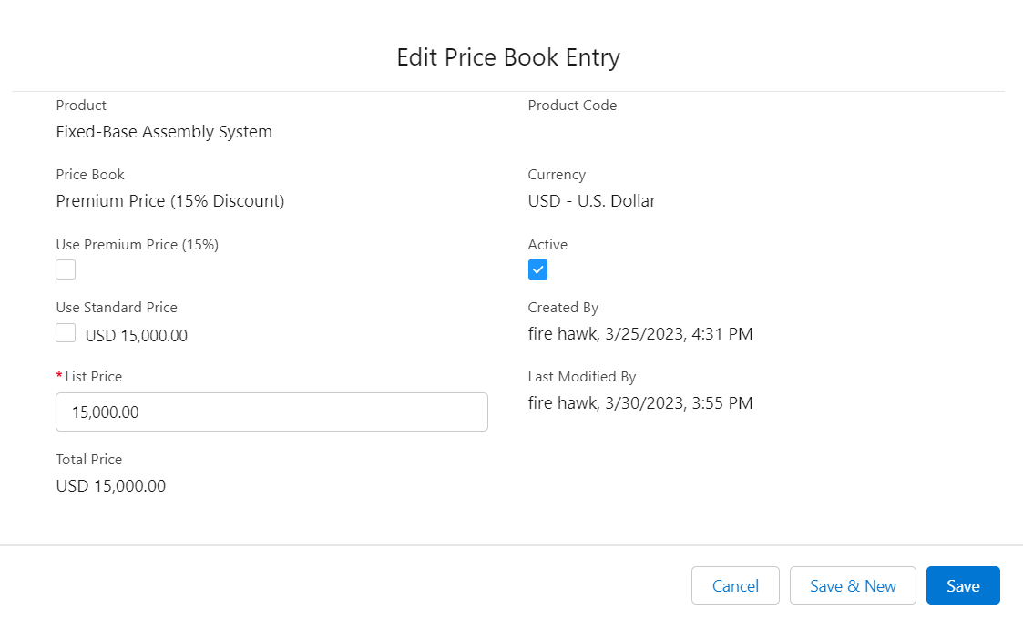
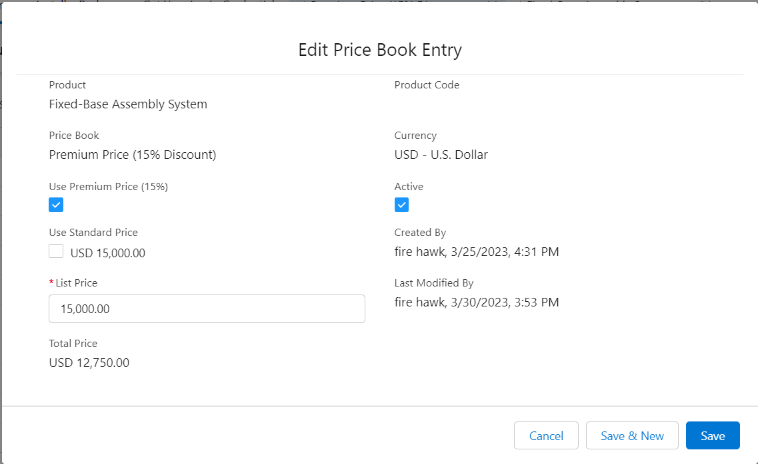
Client Interface
and Benefits
What if I wanna change it within the record itself?
Price with premium checked (after saving)
Price with premium unchecked
Additionally implemented an option for changing product price when editing an entry

Slide 18
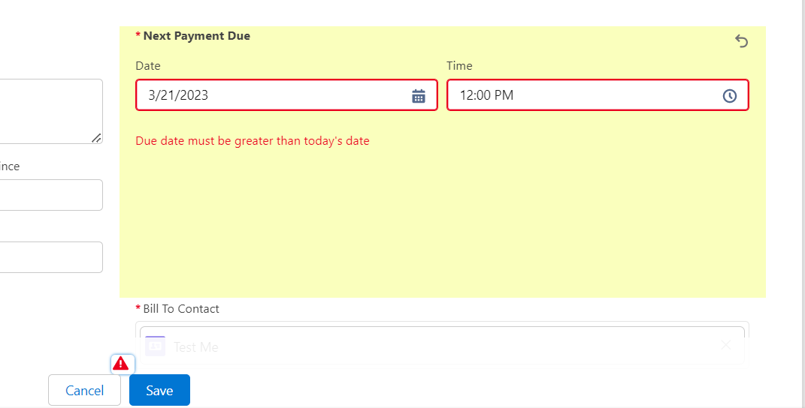
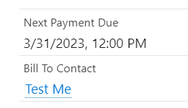
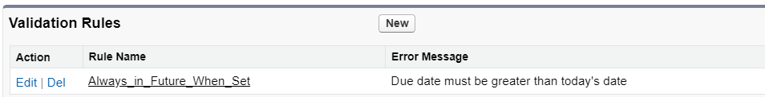
Client Interface and Benefits
If date is set in the past, it will give an error
User will receive a message
When date is set in the future, field saves fine
Validation rule implemented on the field within Orders Object
Formula Used: IF(Next_Payment_Due__c <= NOW(), True, False)
Notes:
Taylor ~ 37: Next Payment Due - Story Pt 2 - Taylor

Slide 19
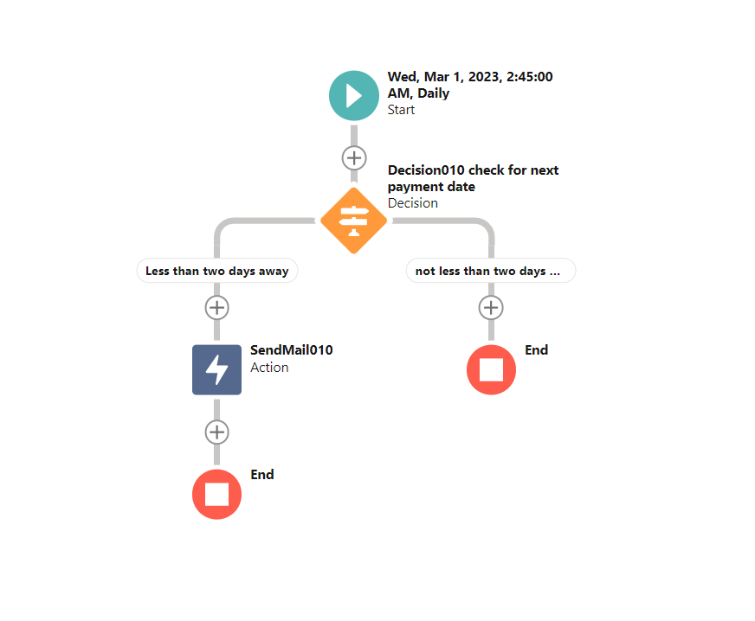
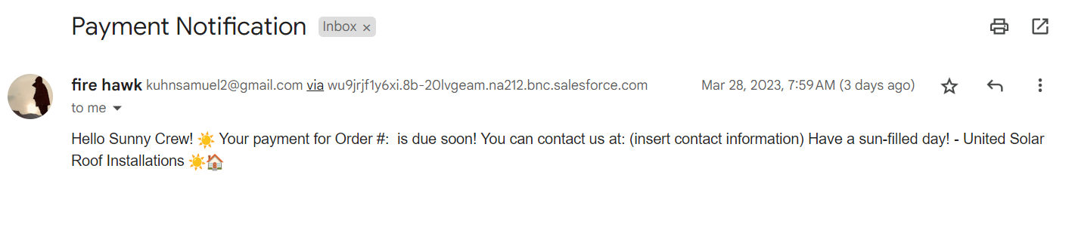
Client Interface and Benefits
Payment notifications: Accounts are now notified via email when their payment is due in two days!
Notes:
Taylor ~ #45 Contact Business When Next Payment Is Due

Slide 20
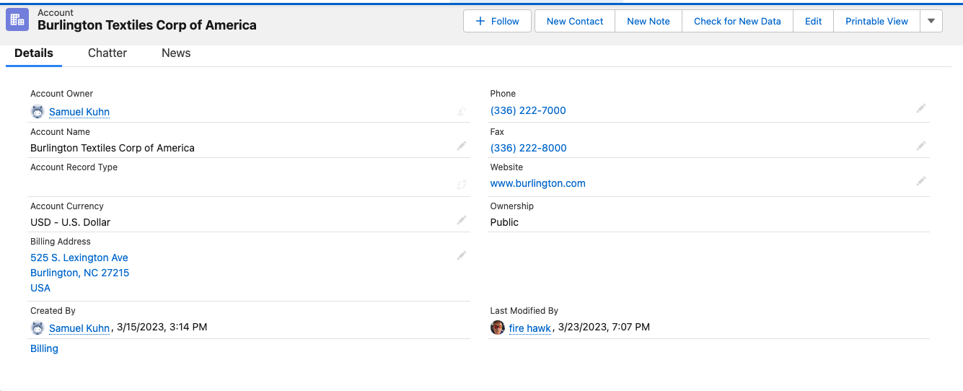
Client Interface and Benefits
Notes:
Use case 16, Engineers only need to see these fields, custom profile called engineeringlayout

Slide 21
Employees and UX
Employees and UX

Slide 22
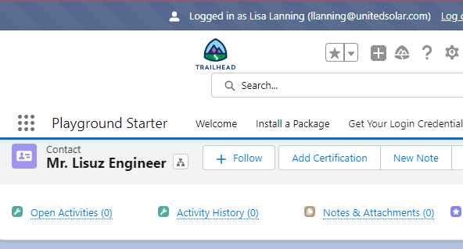
Certifications and Employees
Add Certs
Easily Find
Products Certified
Certified Engineers

Slide 23
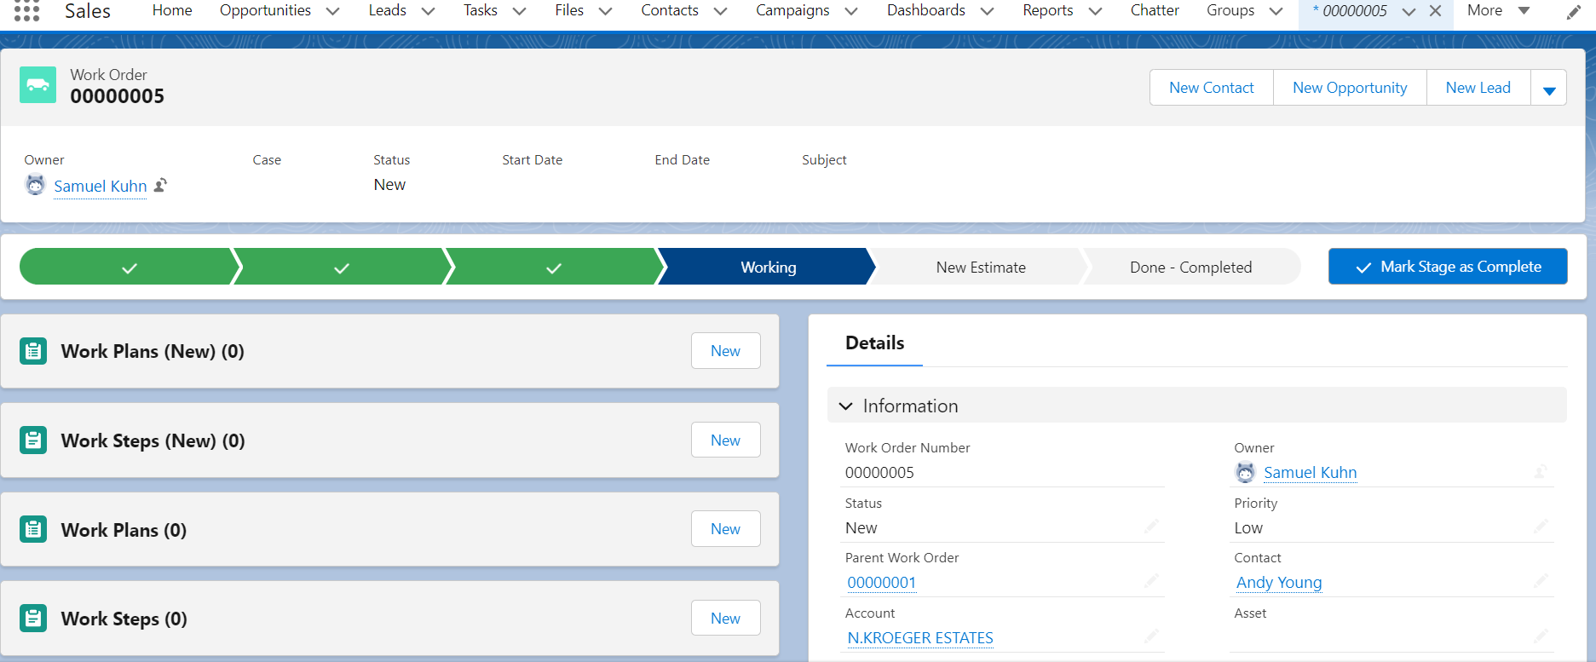
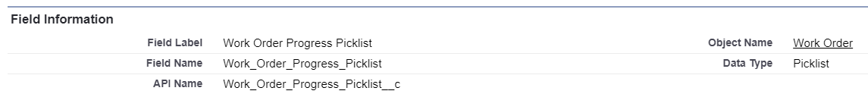
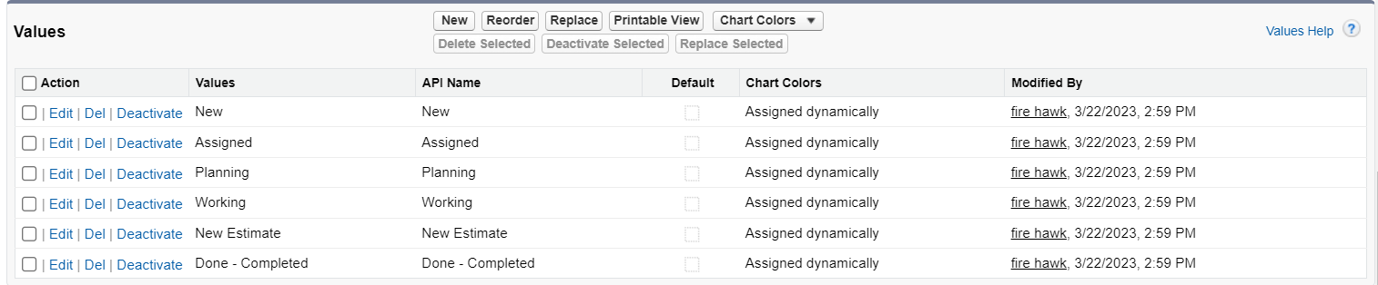
Employee Access and Security
United Solar engineers can now follow a step-by-step process when working on current assignments for installation and repair
A work path progress banner has been implemented in the Work Order Object layout
Notes:
Taylor ~ 21: Track Progress

Slide 24
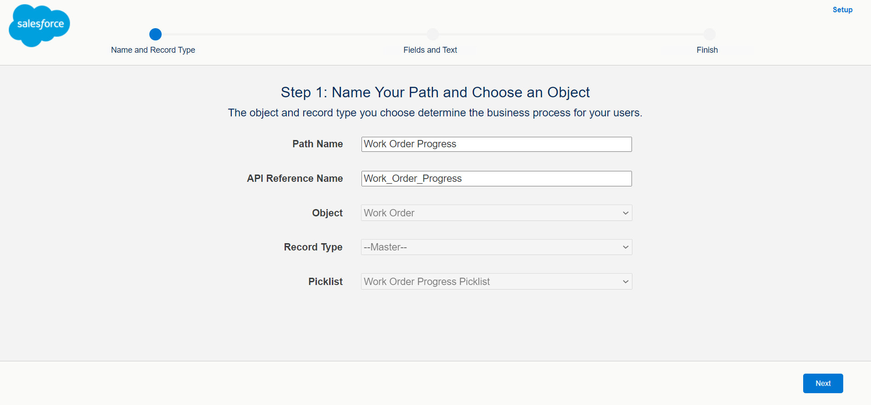
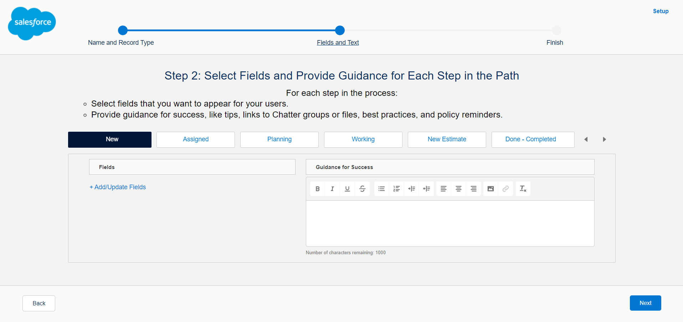
Employee Access and Security
To adjust the steps that show in the path, edit the picklist in object manager; you’re able to add and remove additional!
Easily adjust the fields added to each step and include additional information and encouragement to your employee base!
Notes:
Taylor

Slide 25
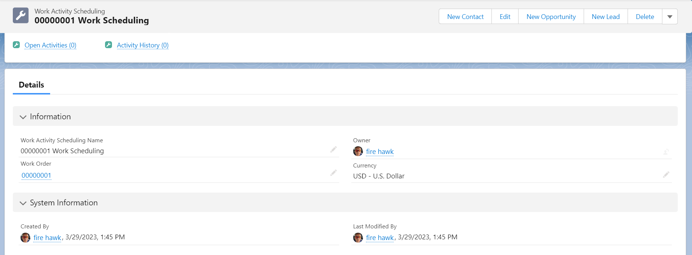
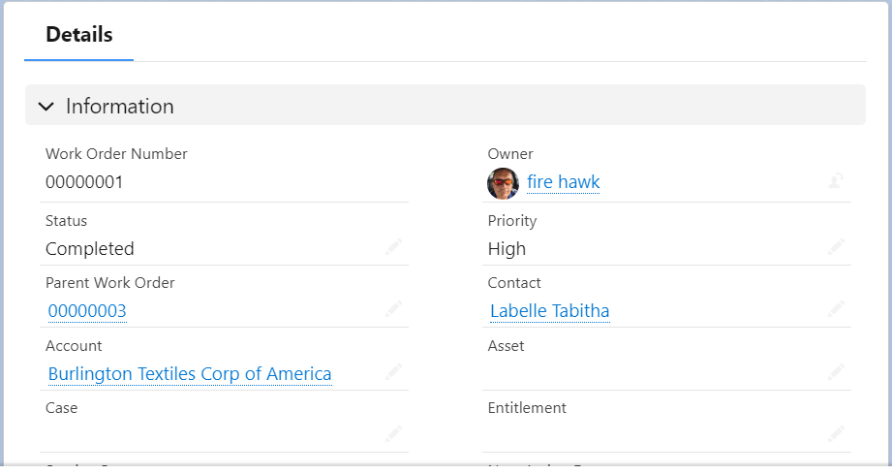
Employee Access and Security
United Solar now has automatic updates to their scheduling object whenever a work order gets completed!
Notes:
Taylor

Slide 26
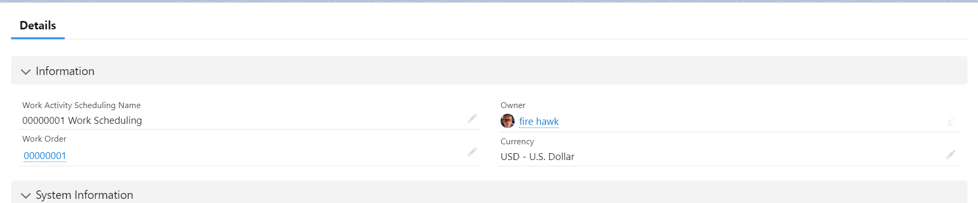
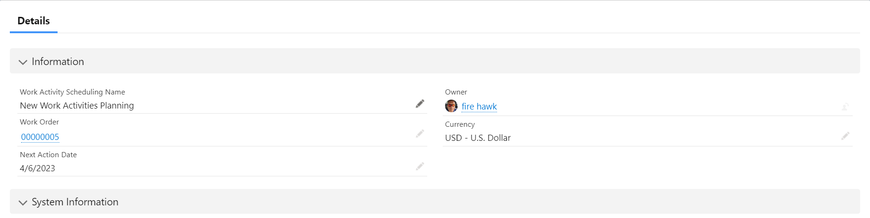
Work Order Status: Complete!
Date gets hidden when the status on the parent object Work Order is completed
Now our engineers’ views are clutter-free!
Work Order Status: Working!

Slide 27
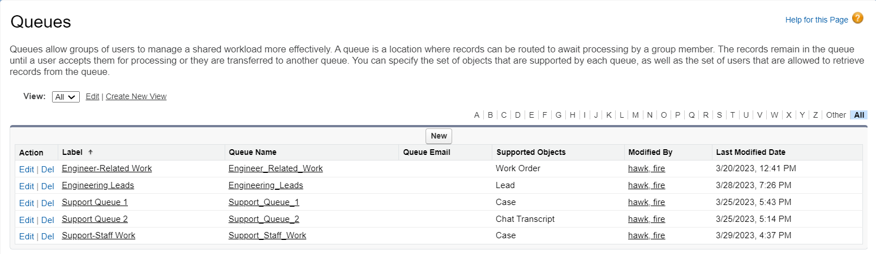
Employee Access and Security
Queues to hold assignments (work orders from cases) for team Engineer and customer support representatives
Notes:
Taylor ~ 4: Engineers Work

Slide 28
Ceo Announcements
CEO wanted a place to make announcement everyone would see
Created a notification alert in chatter so anything coming from the CEO would shows as a notification available for everyone to see

Slide 29
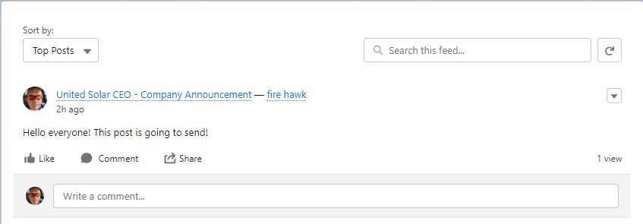
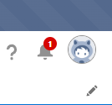
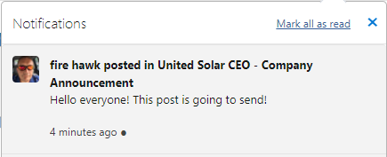
Ceo Announcements
Logged in as Cory Crenshaw notification shows 1
Sent as CEO (firehawk)

Slide 30
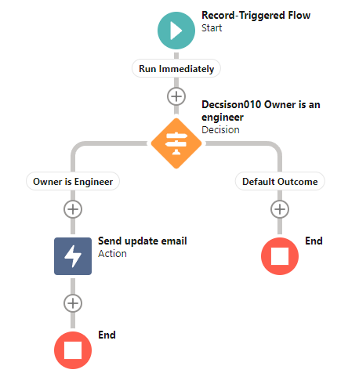
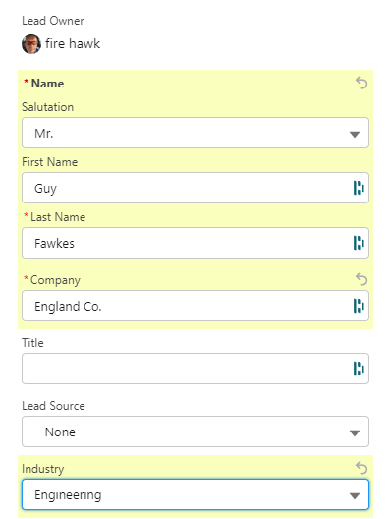
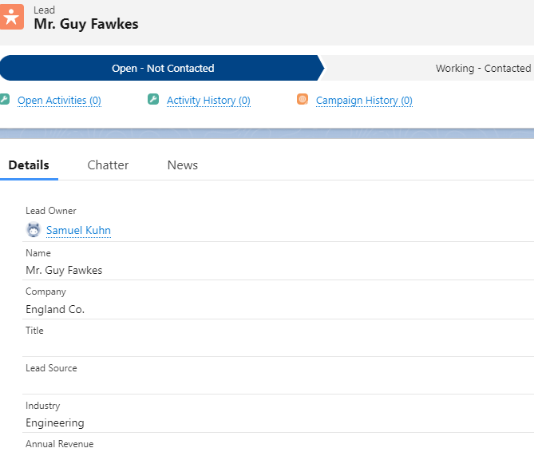
Engineer Workflow
Leads in engineering assigned to Sam (Lisa)*
Engineers are sent an email when assigned a work order
Sam set as engineer, Licences issue

Slide 31
Business Processes
Business Processes

Slide 32
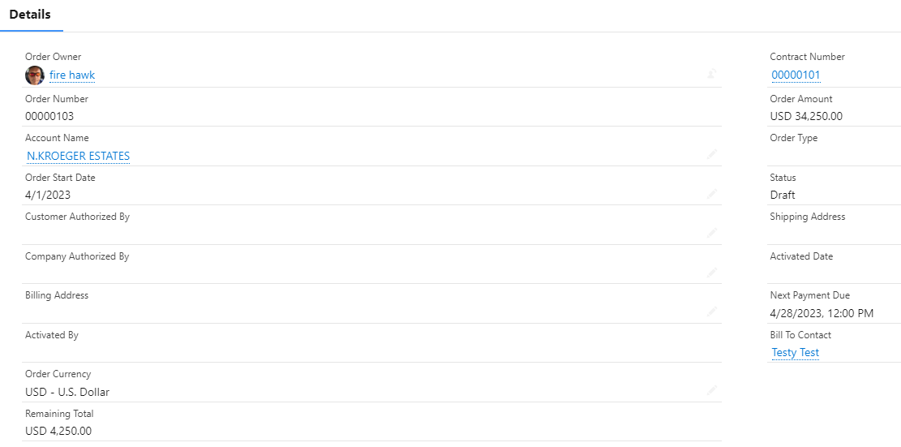
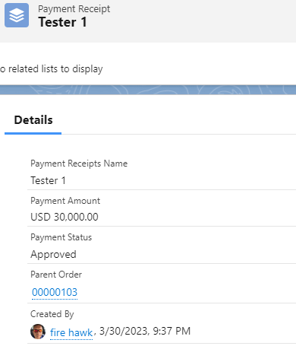
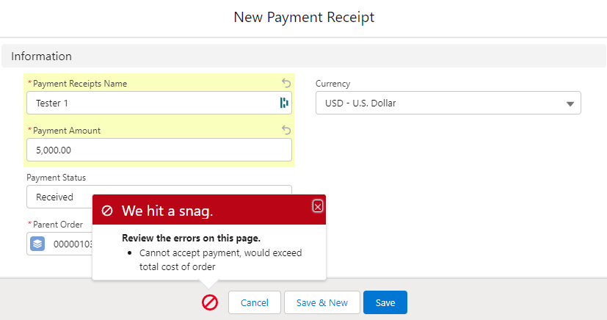
Payment and Price Management
Modified Currency Setting on Company Information for United Solar to use Multiple Currencies
Added Exchange Rates for Yen(Japanese) and Won (Korean)
Order has new field ‘Approved Payments’ and ‘Remaining Total’
Validation rule for Payment receipt ensures new payment receipt cannot exceed Order total

Slide 33
Validation Pictures

Slide 34
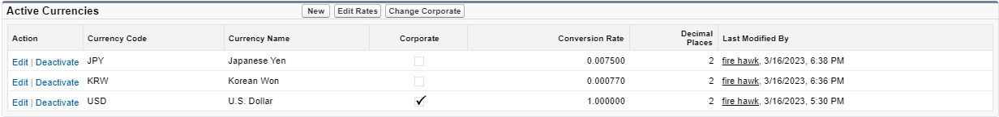
Currencies

Slide 35
Business Process
United Solar request that we add a path to track the progression of a case through the system.
Used Lightning to add path element to top of Case Page
Modified picklist to include options United Solar required:
New
Accepted
In Progress
Delayed
Closed (Failed)
Closed (Success)

Slide 36
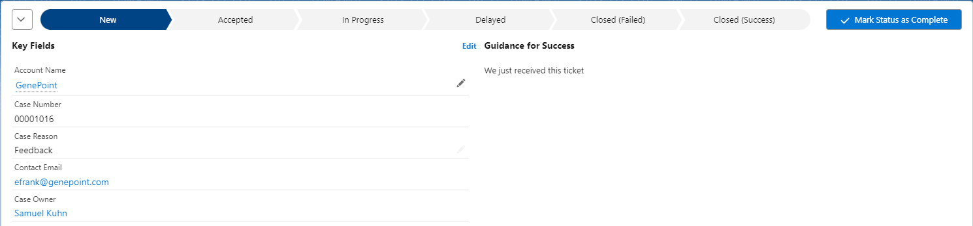
Business Process

Slide 37
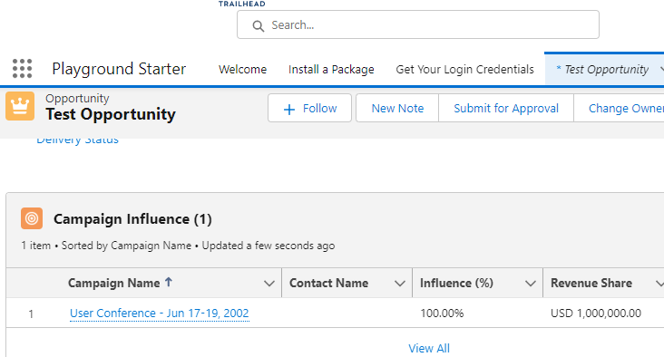
Campaigns and Opportunities
Do you know how well your Marketing Campaigns are working?

Slide 38
Cases and Support
Cases and Support

Slide 39
Email and Case Management
United Solar want to get emails when a ticket was submitted and when then status changed to Accepted
Added email Auto-Response to send user and email when a case is submitted (“New”) and again when it’s status changes to “Accepted” using the case Auto-Response to case criteria

Slide 40
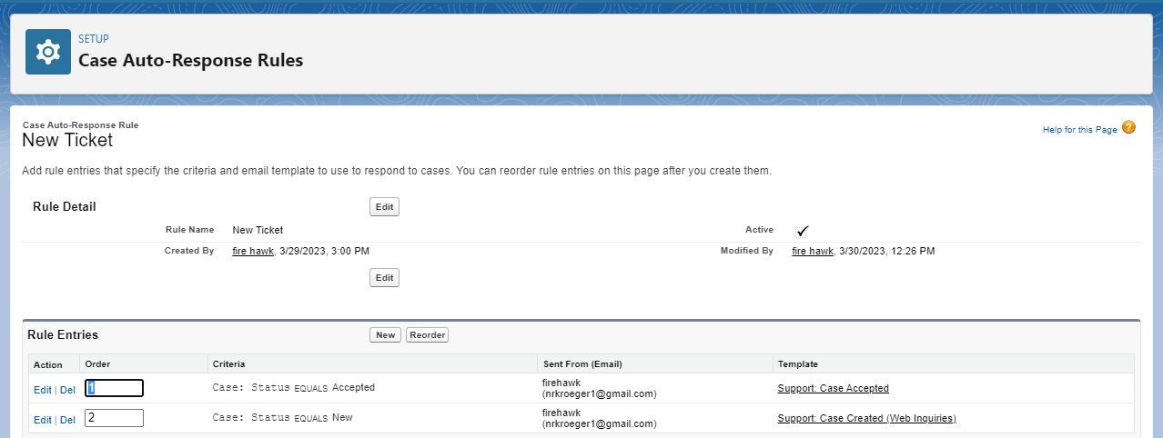
Email and Case Management

Slide 41
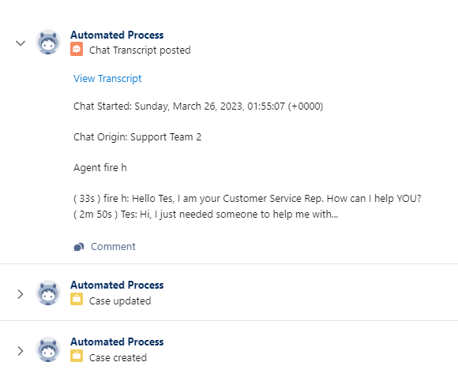
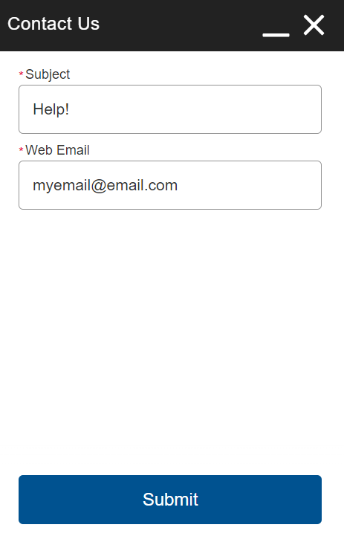
Live Chat with Support
On Salesforce:
On Website:
Request Support on a Website
Chat with a Support Rep
Notes:
Link

Slide 42
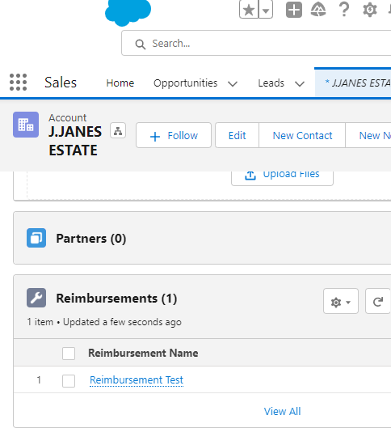
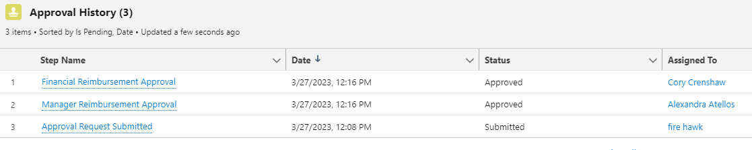
Reimbursement Process
Request Reimbursement from
Account Owner’s Manager
Member of Finance

Slide 43


Expert Articles
Categorized Help Articles

Slide 44


Support Escalation
New cases now get processed faster via the org’s escalation rules; no case sits above two days! Users will be notified when they’re assigned, as well as the case owner!
Notes:
Taylor ~ 27: 2 Days for New

Slide 45
Demos
Email-to-Case/Case stuff
Adding a Certification
Engineer Lead Assignment/Work order notification
Live Chat
Reimbursement Approval
Notes:
Live Chat (link)

Slide 46
Supporting Documents
Supporting Documents
Excel: Google Doc - Project 1 Requirements
Word: Backup and Restore Benefit Analysis
Lucid Chart: Entity Relationship Diagram
Trello: Scrumban Diagram Document

Slide 47
Future Implementations
Future Implementations

